Slide 1


Introduction to Car Sales Price Prediction Project
Our car sales price prediction project aims to develop a model that accurately estimates the sale price of vehicles. By analyzing various attributes and historical pricing data, we intend to provide valuable insights to customers and dealers in the automotive industry.

Slide 2
Data Collection and Preprocessing
Data Gathering
Data Cleaning
Collection from multiple reliable sources, ensuring a comprehensive dataset.
Removing duplicates, handling missing values, and normalizing the dataset.

Slide 3

Feature Selection and Engineering
1
Feature Exploration
2
Feature Transformation
Identifying relevant attributes that influence car prices.
Converting raw data into meaningful features for analysis.

Slide 4
Model Selection and Evaluation
Regression Models
Decision Trees
Ensemble Methods
Support Vector Machines
Neural Networks
Performance Comparison

Slide 5
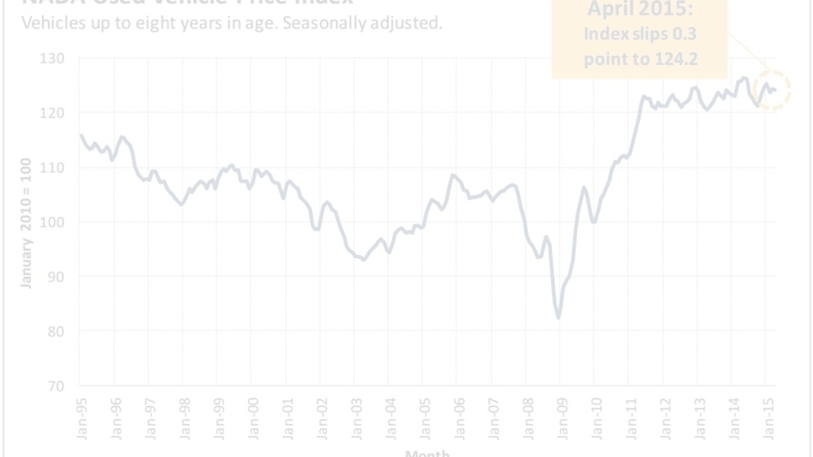
Results and Performance Metrics
Accuracy Analysis
Error Metrics
Evaluating model precision and recall, and F1 scores.
Assessing mean absolute error and root mean squared error.

Slide 6



Challenges and Limitations
Data Variety
Dealing with data inconsistencies and quality issues.
Algorithm Complexity
Addressing the impact of complex models on interpretability.

Slide 7


Future Enhancements and Potential Applications
Continuous Improvement
Global Reach
Exploring advanced algorithms and real-time data integration.
Expanding predictions to international car markets and diverse vehicle types.

Slide 8

Conclusion
1
Project Recap
Summarizing key milestones and achievements in the development process.
2
Lessons Learned
Reflecting on challenges faced and strategies utilized for overcoming them.
3
Future Goals
Outlining the next steps and areas for further research and improvement.

